Slide 1
PREDICTING OPTIMAL LOCATION
FOR SYRIAN STYLE RESTAURANT IN
TORONTO

Slide 2
IDENTIFICATION OF PROBLEMS
Increased number of restaurants of a particular style in the market of food share in the city of Toronto.
The main goal of this project is to find the best location to open the restaurant in Toronto so it is in a place that attracts a lot of people.

Slide 3
DATA ACQUISITION
We have observed that the numbers of the Syrian refugees are growing especially in Canada in Toronto.
We are looking to solve the problem. We will discuss in this report about the best location where one can open the restaurant so that we will be able to higher the Syrian food in the market.
We will choose a location that will be away from the other restaurants and most important that the location is very close to downtown because as we know it's a very tourist popularity.

Slide 4
DATA SOURCE
Toronto postal code data scraped from Wikipedia page
Number of restaurants and their type and location in every neighborhood will be obtained using Foursquare API
Coordinates of downtown Toronto will be obtained using Google latitude and longitude of the CN tower

Slide 5
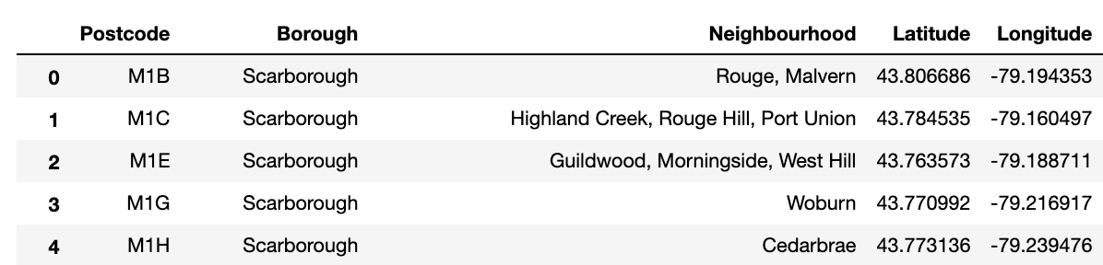
PROCESS OF DATA PERPERATION
AND CLEANING
Data were refined to be developed the panda's data frame which will include the borough, neighborhood, postal code and finally the longitude.

Slide 6
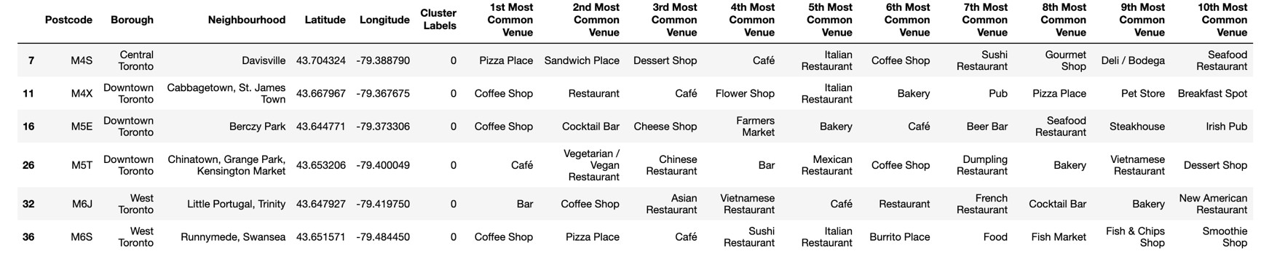
PROCESS OF DATA PERPERATION
AND CLEANING
Using Foursquare API locations, we identified 10 best places of the neighborhood, we refined the data frame in such a way so that we had only the neighborhoods that have a food category the best 10.

Slide 7
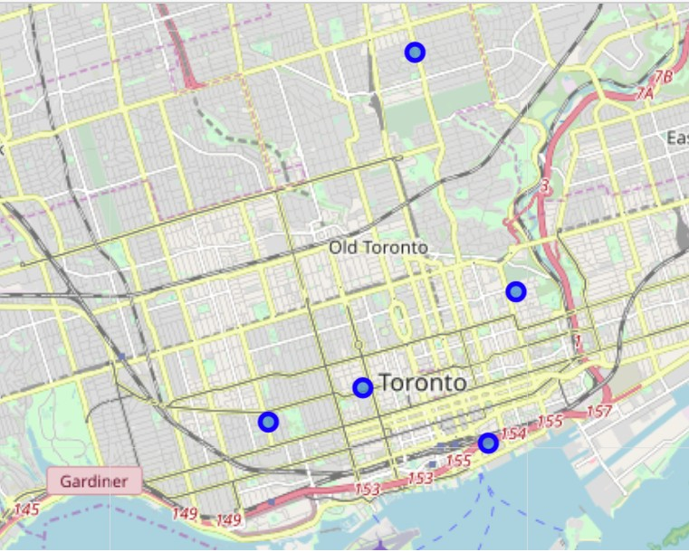
Exploratory data analysis
We used Folium MAPS to find hotspots that will be perfect for the restaurant visualize the locations.

Slide 8
HOTSPOTS
When we applied explore URL analysis with the Arabic Syrian style restaurant place category ID to every hotspot of the restaurant, we identified that there isn't much restaurants close to the hotspots.
Parameter in URL: Result by 100-500m radius.
We identified 6 restaurant hotspots don't have an Arabic Syrian style restaurant in the 500m radius.

Slide 9
RESULTS AND DISCUSSION
We found that CN tower, or Canadian National Tower that has been built by a railway company of the same name is the main tourist attraction of Downtown Toronto so the Berczy Park is the perfect place to open the restaurant but we have our own rules the restaurant hotspot location should be 10 or more food category places provided by Foursquare API It does not have many Syrian style restaurants in a 500m radius is the closest to our chosen tourist attraction, the CN Tower.

Slide 10
FINAL MESSAGE/CONCLUSION
Arabic Syrian restaurants are not common in Toronto.
Berczy Park is the perfect place for the restaurants.

